Slide 1
BM742 Performance Management
Chapter 1:
Introduction to Performance Management Systems
Primary Reference Book:
Performance Management: Key strategies and practices by Michael Armstrong

Slide 2
Performance Management
PERFORMANCE MANAGEMENT DEFINED
Performance management can be defined as a systematic process for improving organizational performance by developing the performance of individuals and teams.

Slide 3
Performance Management
PERFORMANCE MANAGEMENT DEFINED (contd)
the process of ‘Directing and supporting employees to work as effectively and efficiently as possible in line with the needs of the organization’ (Walters).

Slide 4
Performance Management
PERFORMANCE MANAGEMENT DEFINED (contd)
‘Performance management is a strategic and integrated approach to delivering sustained success to organisations by improving the performance of the people who work in them and by developing the capabilities of teams and individual contributors’ (Armstrong and Baron)

Slide 5
Performance Management
Aims of Performance Management
Establishment of High Performance Culture
Goal Clarity
Communication of objectives and expected skills and behaviors
Alignment of Individual and Organizational objectives
Development of workforce
Provision of continuous support and feedback to facilitate employee/team performance.
The alignment of personal/individual objectives with team, department/divisional and corporate plans.

Slide 6
Performance Management
Elements of Performance Management
Agreement
Role Requirements
Objectives/Targets
Standards
performance measures
Indicators
personal development plans

Slide 7
Performance Management
Elements of Performance Management (Contd)
Measurement
On-going dialogue
joint and continuing review of achievements against objectives, requirements and plans.

Slide 8
Performance Management
Elements of Performance Management (Contd)
Feedback
Continuous Feedback Vs End of Review Feedback
Compassion
Positive Reinforcement
Developmental Needs
Dialogue

Slide 9
Performance Management
DEVELOPMENTS IN PERFORMANCE MANAGEMENT
an emphasis on front-end planning rather than back-end review;
l a broader definition of performance that focuses on more than narrowly defined job responsibilities;
an emphasis on ongoing dialogue rather than forms and rating scales;
the recognition that there are many factors contributing to performance outcomes.

Slide 10
Performance Management
CONCERNS OF PERFORMANCE MANAGEMENT
Concern with outputs, outcomes, process and inputs.
Concern with planning.
Concern with measurement and review
‘If you can’t measure it you can’t manage it.’
Concern with continuous improvement/development.
Concern for communication
Concern for stakeholders
Concern for fairness and transparency

Slide 11
Performance Management
GUIDING PRINCIPLES OF PERFORMANCE MANAGEMENT
“Most employees want direction, freedom to get their work done, and encouragement not control. The performance management system should be a control system only by exception. The solution is to make it a collaborative development system in two ways. First, the entire performance management process – coaching, counselling, feedback, tracking, recognition, and so forth – should encourage development. Ideally, team members grow and develop through these interactions. Second, when managers and team members ask what they need to be able to do to do bigger and better things, they move to strategic development.”

Slide 12
Performance Management
Performance Appraisal Vs Performance Management
Appraisal as part of holistic Performance Management Process
Usage of Appraisal information for
Training and development Strategy
Reward and compensation strategy
Succession Planning Strategy
Transfers and deployment Strategy

Slide 13
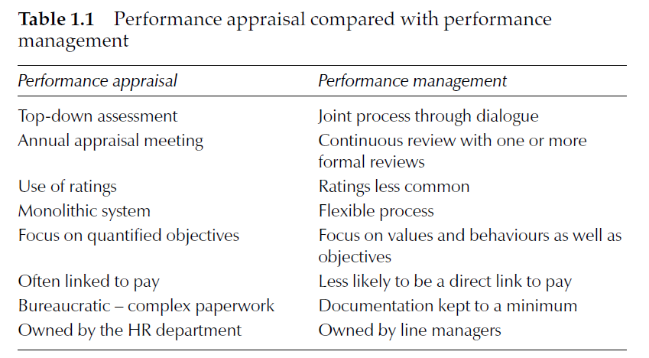
Performance Management

Slide 14
Performance Management
PERFORMANCE MANAGEMENT AND THE PSYCHOLOGICAL CONTRACT
A psychological contract is a system of beliefs that encompasses the actions employees believe are expected of them and what response they expect in return from their employer.
A positive psychological contract is one in which both parties the employee and the employer agree on mutual expectations and pursue courses of action that provide for those expectations to be realized.
Performance management has an important part to play in developing a positive psychological contract.

